Slide 1
Data Mining:
Concepts and Techniques
— Slides for Textbook —
— Chapter 7 —
©Jiawei Han and Micheline Kamber
Department of Computer Science
University of Illinois at Urbana-Champaign
www.cs.uiuc.edu/~hanj

Slide 2
Chapter 7. Classification and Prediction
What is classification? What is prediction?
Issues regarding classification and prediction
Classification by decision tree induction
Bayesian Classification
Classification by Neural Networks
Classification by Support Vector Machines (SVM)
Classification based on concepts from association rule mining
Other Classification Methods
Prediction
Classification accuracy
Summary

Slide 3
Classification vs. Prediction
Classification:
  predicts categorical class labels (discrete or nominal)
  classifies data (constructs a model) based on the training set and the values (class labels) in a classifying attribute and uses it in classifying new data
Prediction:
  models continuous-valued functions, i.e., predicts unknown or missing values
Typical Applications
  credit approval
  target marketing
  medical diagnosis
  treatment effectiveness analysis

Slide 4
Classification—A Two-Step Process
Model construction: describing a set of predetermined classes
  Each tuple/sample is assumed to belong to a predefined class, as determined by the class label attribute
  The set of tuples used for model construction is training set
  The model is represented as classification rules, decision trees, or mathematical formulae
Model usage: for classifying future or unknown objects
  Estimate accuracy of the model
    The known label of test sample is compared with the classified result from the model
    Accuracy rate is the percentage of test set samples that are correctly classified by the model
    Test set is independent of training set, otherwise over-fitting will occur
  If the accuracy is acceptable, use the model to classify data tuples whose class labels are not known

Slide 5



Classification Process (1): Model Construction
Classification
Algorithms
Training
Data
Classifier
(Model)
IF rank = ‘professor’
OR years > 6
THEN tenured = ‘yes’

Slide 6




Classification Process (2): Use the Model in Prediction
Classifier
Testing
Data
Unseen Data
(Jeff, Professor, 4)
Tenured?

Slide 7
Supervised vs. Unsupervised Learning
Supervised learning (classification)
  Supervision: The training data (observations, measurements, etc.) are accompanied by labels indicating the class of the observations
  New data is classified based on the training set
Unsupervised learning (clustering)
  The class labels of training data is unknown
  Given a set of measurements, observations, etc. with the aim of establishing the existence of classes or clusters in the data

Slide 8
Chapter 7. Classification and Prediction
What is classification? What is prediction?
Issues regarding classification and prediction
Classification by decision tree induction
Bayesian Classification
Classification by Neural Networks
Classification by Support Vector Machines (SVM)
Classification based on concepts from association rule mining
Other Classification Methods
Prediction
Classification accuracy
Summary

Slide 9
Issues Regarding Classification and Prediction (1): Data Preparation
Data cleaning
  Preprocess data in order to reduce noise and handle missing values
Relevance analysis (feature selection)
  Remove the irrelevant or redundant attributes
Data transformation
  Generalize and/or normalize data

Slide 10
Issues regarding classification and prediction (2): Evaluating Classification Methods
Predictive accuracy
Speed and scalability
  time to construct the model
  time to use the model
Robustness
  handling noise and missing values
Scalability
  efficiency in disk-resident databases
Interpretability:
  understanding and insight provided by the model
Goodness of rules
  decision tree size
  compactness of classification rules

Slide 11
Chapter 7. Classification and Prediction
What is classification? What is prediction?
Issues regarding classification and prediction
Classification by decision tree induction
Bayesian Classification
Classification by Neural Networks
Classification by Support Vector Machines (SVM)
Classification based on concepts from association rule mining
Other Classification Methods
Prediction
Classification accuracy
Summary

Slide 12
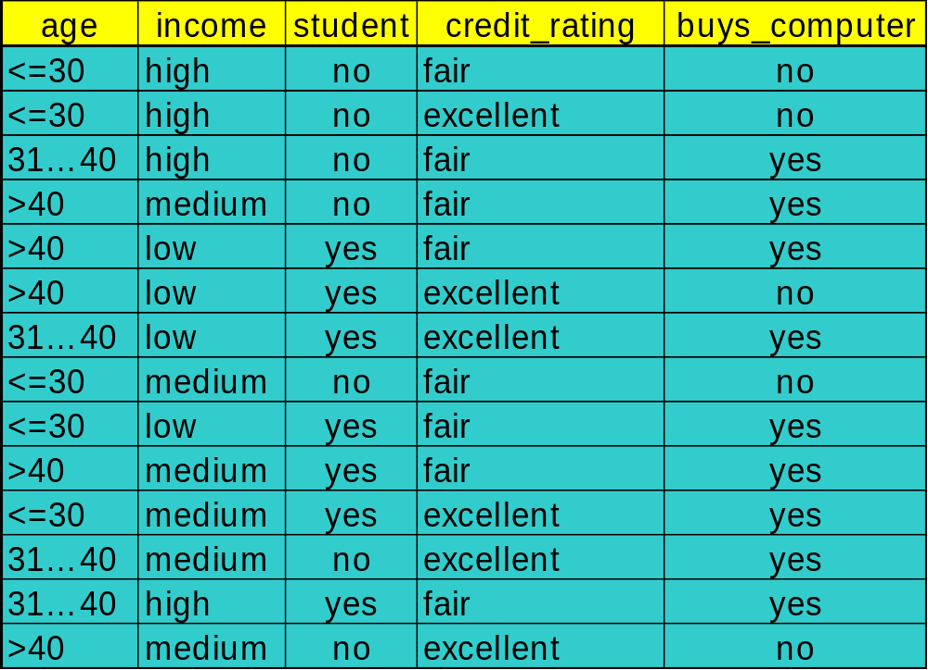
Training Dataset
This follows an example from Quinlan’s ID3

Slide 13
Output: A Decision Tree for “buys_computer”
age?
<=30
overcast
>40
30..40
student?
yes
credit rating?
no
yes
excellent
fair
no
yes
no
yes

Slide 14
Algorithm for Decision Tree Induction
Basic algorithm (a greedy algorithm)
  Tree is constructed in a top-down recursive divide-and-conquer manner
  At start, all the training examples are at the root
  Attributes are categorical (if continuous-valued, they are discretized in advance)
  Examples are partitioned recursively based on selected attributes
  Test attributes are selected on the basis of a heuristic or statistical measure (e.g., information gain)
Conditions for stopping partitioning
  All samples for a given node belong to the same class
  There are no remaining attributes for further partitioning – majority voting is employed for classifying the leaf
  There are no samples left

Slide 15
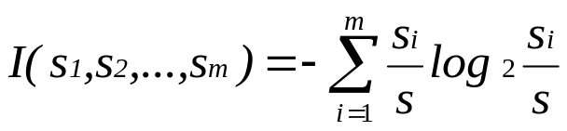
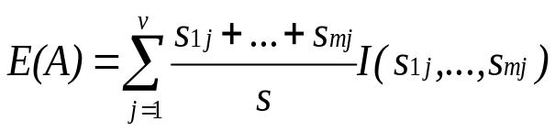

Attribute Selection Measure: Information Gain (ID3/C4.5)
Select the attribute with the highest information gain
S contains s_{i} tuples of class C_{i} for i = {1, …, m}
information measures info required to classify any arbitrary tuple
entropy of attribute A with values {a₁,a₂,…,a_{v}}
information gained by branching on attribute A
Notes:
Then how can we decide a test attribute on each node?
One of the popular methods is using information gain measure, which we covered in chapter 5.
It involves rather complicated equations, and I’ll not present the details here. Just basic ideas.
The basic idea is that we select the attribute with the highest information gain.
This information gain can be calculated from the expected information I and entropy of each attribute, E
I : the expected information needed to classify a given sample
E (entropy) : expected information based on the partitioning into subsets by A

Slide 16
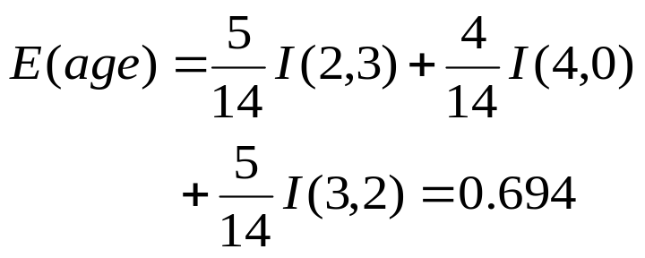



Attribute Selection by Information Gain Computation
Class P: buys_computer = “yes”
Class N: buys_computer = “no”
I(p, n) = I(9, 5) =0.940
Compute the entropy for age:
means “age <=30” has 5 out of 14 samples, with 2 yes’es and 3 no’s. Hence
Similarly,

Slide 17
Other Attribute Selection Measures
Gini index (CART, IBM IntelligentMiner)
  All attributes are assumed continuous-valued
  Assume there exist several possible split values for each attribute
  May need other tools, such as clustering, to get the possible split values
  Can be modified for categorical attributes

Slide 18
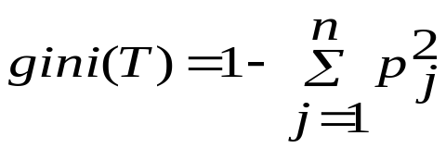
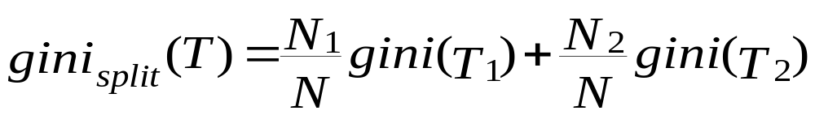
Gini Index (IBM IntelligentMiner)
If a data set T contains examples from n classes, gini index, gini(T) is defined as
where p_{j} is the relative frequency of class j in T.
If a data set T is split into two subsets T₁ and T₂ with sizes N₁ and N₂ respectively, the gini index of the split data contains examples from n classes, the gini index gini(T) is defined as
The attribute provides the smallest gini_{split}(T) is chosen to split the node (need to enumerate all possible splitting points for each attribute).

Slide 19
Extracting Classification Rules from Trees
Represent the knowledge in the form of IF-THEN rules
One rule is created for each path from the root to a leaf
Each attribute-value pair along a path forms a conjunction
The leaf node holds the class prediction
Rules are easier for humans to understand
Example
  IF age = “<=30” AND student = “no” THEN buys_computer = “no”
  IF age = “<=30” AND student = “yes” THEN buys_computer = “yes”
  IF age = “31…40” THEN buys_computer = “yes”
  IF age = “>40” AND credit_rating = “excellent” THEN buys_computer = “yes”
  IF age = “<=30” AND credit_rating = “fair” THEN buys_computer = “no”

Slide 20
Avoid Overfitting in Classification
Overfitting: An induced tree may overfit the training data
  Too many branches, some may reflect anomalies due to noise or outliers
  Poor accuracy for unseen samples
Two approaches to avoid overfitting
  Prepruning: Halt tree construction early—do not split a node if this would result in the goodness measure falling below a threshold
    Difficult to choose an appropriate threshold
  Postpruning: Remove branches from a “fully grown” tree—get a sequence of progressively pruned trees
    Use a set of data different from the training data to decide which is the “best pruned tree”

Slide 21
Approaches to Determine the Final Tree Size
Separate training (2/3) and testing (1/3) sets
Use cross validation, e.g., 10-fold cross validation
Use all the data for training
  but apply a statistical test (e.g., chi-square) to estimate whether expanding or pruning a node may improve the entire distribution
Use minimum description length (MDL) principle
  halting growth of the tree when the encoding is minimized

Slide 22
Enhancements to basic decision tree induction
Allow for continuous-valued attributes
  Dynamically define new discrete-valued attributes that partition the continuous attribute value into a discrete set of intervals
Handle missing attribute values
  Assign the most common value of the attribute
  Assign probability to each of the possible values
Attribute construction
  Create new attributes based on existing ones that are sparsely represented
  This reduces fragmentation, repetition, and replication

Slide 23
Classification in Large Databases
Classification—a classical problem extensively studied by statisticians and machine learning researchers
Scalability: Classifying data sets with millions of examples and hundreds of attributes with reasonable speed
Why decision tree induction in data mining?
  relatively faster learning speed (than other classification methods)
  convertible to simple and easy to understand classification rules
  can use SQL queries for accessing databases
  comparable classification accuracy with other methods

Slide 24
Scalable Decision Tree Induction Methods in Data Mining Studies
SLIQ (EDBT’96 — Mehta et al.)
  builds an index for each attribute and only class list and the current attribute list reside in memory
SPRINT (VLDB’96 — J. Shafer et al.)
  constructs an attribute list data structure
PUBLIC (VLDB’98 — Rastogi & Shim)
  integrates tree splitting and tree pruning: stop growing the tree earlier
RainForest (VLDB’98 — Gehrke, Ramakrishnan & Ganti)
  separates the scalability aspects from the criteria that determine the quality of the tree
  builds an AVC-list (attribute, value, class label)

Slide 25
Data Cube-Based Decision-Tree Induction
Integration of generalization with decision-tree induction (Kamber et al’97).
Classification at primitive concept levels
  E.g., precise temperature, humidity, outlook, etc.
  Low-level concepts, scattered classes, bushy classification-trees
  Semantic interpretation problems.
Cube-based multi-level classification
  Relevance analysis at multi-levels.
  Information-gain analysis with dimension + level.

Slide 26

Presentation of Classification Results

Slide 27

Visualization of a Decision Tree in SGI/MineSet 3.0

Slide 28

Interactive Visual Mining by Perception-Based Classification (PBC)

Slide 29
Chapter 7. Classification and Prediction
What is classification? What is prediction?
Issues regarding classification and prediction
Classification by decision tree induction
Bayesian Classification
Classification by Neural Networks
Classification by Support Vector Machines (SVM)
Classification based on concepts from association rule mining
Other Classification Methods
Prediction
Classification accuracy
Summary

Slide 30
Bayesian Classification: Why?
Probabilistic learning: Calculate explicit probabilities for hypothesis, among the most practical approaches to certain types of learning problems
Incremental: Each training example can incrementally increase/decrease the probability that a hypothesis is correct. Prior knowledge can be combined with observed data.
Probabilistic prediction: Predict multiple hypotheses, weighted by their probabilities
Standard: Even when Bayesian methods are computationally intractable, they can provide a standard of optimal decision making against which other methods can be measured

Slide 31
Bayesian Theorem: Basics
Let X be a data sample whose class label is unknown
Let H be a hypothesis that X belongs to class C
For classification problems, determine P(H/X): the probability that the hypothesis holds given the observed data sample X
P(H): prior probability of hypothesis H (i.e. the initial probability before we observe any data, reflects the background knowledge)
P(X): probability that sample data is observed
P(X|H) : probability of observing the sample X, given that the hypothesis holds

Slide 32
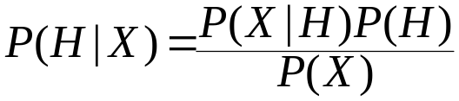
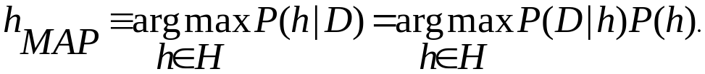
Bayesian Theorem
Given training data X, posteriori probability of a hypothesis H, P(H|X) follows the Bayes theorem
Informally, this can be written as
  posterior =likelihood x prior / evidence
MAP (maximum posteriori) hypothesis
Practical difficulty: require initial knowledge of many probabilities, significant computational cost

Slide 33

Naïve Bayes Classifier
A simplified assumption: attributes are conditionally independent:
The product of occurrence of say 2 elements x₁ and x₂, given the current class is C, is the product of the probabilities of each element taken separately, given the same class P([y₁,y₂],C) = P(y₁,C) * P(y₂,C)
No dependence relation between attributes
Greatly reduces the computation cost, only count the class distribution.
Once the probability P(X|C_{i}) is known, assign X to the class with maximum P(X|C_{i})*P(C_{i})

Slide 34
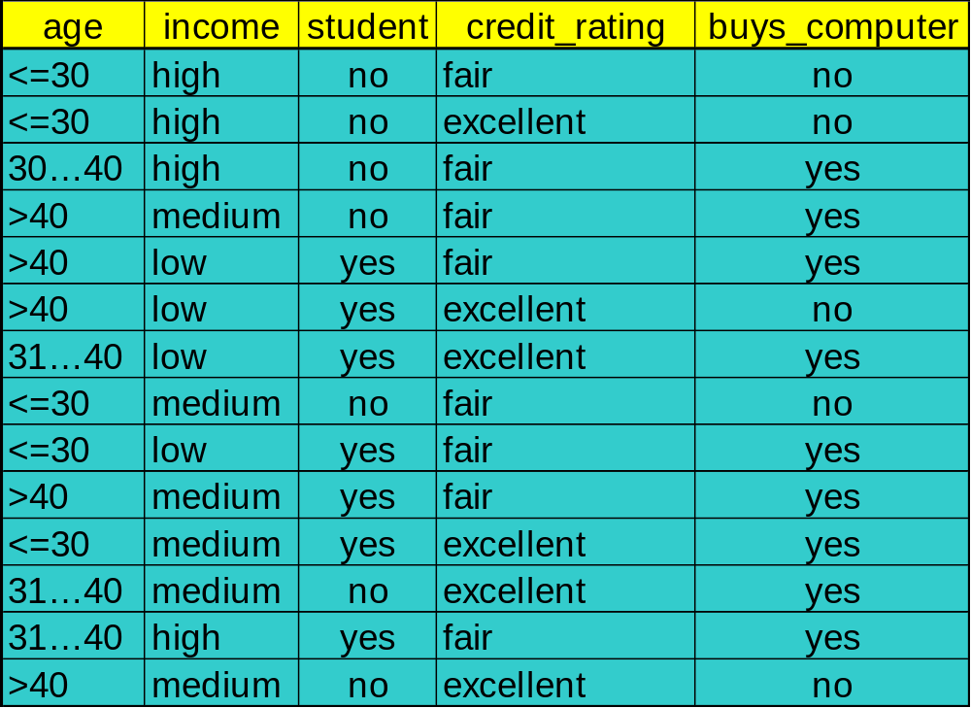
Training dataset
Class:
C1:buys_computer=
‘yes’
C2:buys_computer=
‘no’
Data sample
X =(age<=30,
Income=medium,
Student=yes
Credit_rating=
Fair)

Slide 35
Naïve Bayesian Classifier: Example
Compute P(X/Ci) for each class
P(age=“<30” | buys_computer=“yes”) = 2/9=0.222
P(age=“<30” | buys_computer=“no”) = 3/5 =0.6
P(income=“medium” | buys_computer=“yes”)= 4/9 =0.444
P(income=“medium” | buys_computer=“no”) = 2/5 = 0.4
P(student=“yes” | buys_computer=“yes)= 6/9 =0.667
P(student=“yes” | buys_computer=“no”)= 1/5=0.2
P(credit_rating=“fair” | buys_computer=“yes”)=6/9=0.667
P(credit_rating=“fair” | buys_computer=“no”)=2/5=0.4
X=(age<=30 ,income =medium, student=yes,credit_rating=fair)
P(X|Ci) : P(X|buys_computer=“yes”)= 0.222 x 0.444 x 0.667 x 0.0.667 =0.044
P(X|buys_computer=“no”)= 0.6 x 0.4 x 0.2 x 0.4 =0.019
P(X|Ci)*P(Ci ) : P(X|buys_computer=“yes”) * P(buys_computer=“yes”)=0.028
P(X|buys_computer=“yes”) * P(buys_computer=“yes”)=0.007
X belongs to class “buys_computer=yes”

Slide 36
Naïve Bayesian Classifier: Comments
Advantages :
  Easy to implement
  Good results obtained in most of the cases
Disadvantages
  Assumption: class conditional independence , therefore loss of accuracy
  Practically, dependencies exist among variables
  E.g., hospitals: patients: Profile: age, family history etc
  Symptoms: fever, cough etc., Disease: lung cancer, diabetes etc
  Dependencies among these cannot be modeled by Naïve Bayesian Classifier
How to deal with these dependencies?
  Bayesian Belief Networks

Slide 37
Bayesian Networks
Bayesian belief network allows a subset of the variables conditionally independent
A graphical model of causal relationships
  Represents dependency among the variables
  Gives a specification of joint probability distribution
Nodes: random variables
Links: dependency
X,Y are the parents of Z, and Y is the parent of P
No dependency between Z and P
Has no loops or cycles
X
Y
Z
P

Slide 38
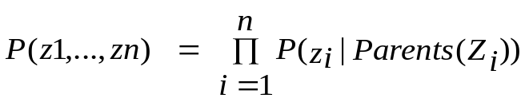
Bayesian Belief Network: An Example
Family
History
Smoker
(FH, S)
(FH, ~S)
(~FH, S)
(~FH, ~S)
LC
0.8
0.5
0.7
0.1
LungCancer
Emphysema
~LC
0.2
0.5
0.3
0.9
The conditional probability table for the variable LungCancer:
Shows the conditional probability for each possible combination of its parents
PositiveXRay
Dyspnea
Bayesian Belief Networks

Slide 39
Learning Bayesian Networks
Several cases
  Given both the network structure and all variables observable: learn only the CPTs
  Network structure known, some hidden variables: method of gradient descent, analogous to neural network learning
  Network structure unknown, all variables observable: search through the model space to reconstruct graph topology
  Unknown structure, all hidden variables: no good algorithms known for this purpose
D. Heckerman, Bayesian networks for data mining

Slide 40
Chapter 7. Classification and Prediction
What is classification? What is prediction?
Issues regarding classification and prediction
Classification by decision tree induction
Bayesian Classification
Classification by Neural Networks
Classification by Support Vector Machines (SVM)
Classification based on concepts from association rule mining
Other Classification Methods
Prediction
Classification accuracy
Summary

Slide 41
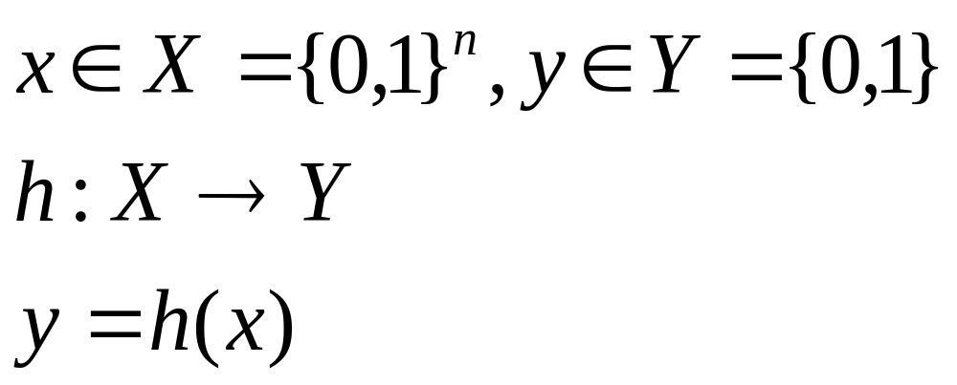
Classification
Classification:
  predicts categorical class labels
Typical Applications
  {credit history, salary}-> credit approval ( Yes/No)
  {Temp, Humidity} --> Rain (Yes/No)
Mathematically

Slide 42
Linear Classification
Binary Classification problem
The data above the red line belongs to class ‘x’
The data below red line belongs to class ‘o’
Examples – SVM, Perceptron, Probabilistic Classifiers
x
x
x
x
x
x
x
x
o
x
o
x
o
o
o
o
o
o
o
o
o
o
o

Slide 43
Discriminative Classifiers
Advantages
  prediction accuracy is generally high
    (as compared to Bayesian methods – in general)
  robust, works when training examples contain errors
  fast evaluation of the learned target function
    (Bayesian networks are normally slow)
Criticism
  long training time
  difficult to understand the learned function (weights)
    (Bayesian networks can be used easily for pattern discovery)
  not easy to incorporate domain knowledge
    (easy in the form of priors on the data or distributions)

Slide 44
Neural Networks
Analogy to Biological Systems (Indeed a great example of a good learning system)
Massive Parallelism allowing for computational efficiency
The first learning algorithm came in 1959 (Rosenblatt) who suggested that if a target output value is provided for a single neuron with fixed inputs, one can incrementally change weights to learn to produce these outputs using the perceptron learning rule

Slide 45
A Neuron
-
μ_{k}
x₀
w₀
x₁
w₁
∑
f
output y
x_{n}
w_{n}
Input
vector x
weight
vector w
weighted
sum
Activation
function
The n-dimensional input vector x is mapped into variable y by means of the scalar product and a nonlinear function mapping

Slide 46
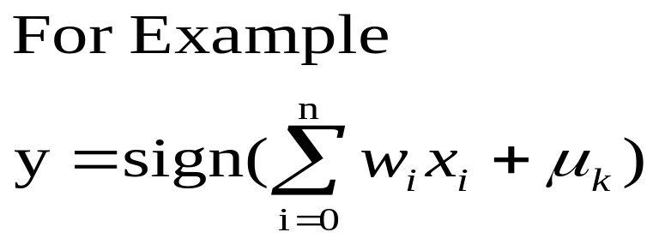
A Neuron
-
μ_{k}
x₀
w₀
x₁
w₁
∑
f
output y
x_{n}
w_{n}
Input
vector x
weight
vector w
weighted
sum
Activation
function

Slide 47




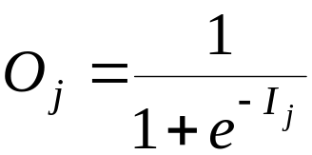
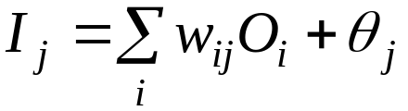
Multi-Layer Perceptron
Output vector
Output nodes
Hidden nodes
w_{ij}
Input nodes
Input vector: x_{i}

Slide 48
Network Training
The ultimate objective of training
  obtain a set of weights that makes almost all the tuples in the training data classified correctly
Steps
  Initialize weights with random values
  Feed the input tuples into the network one by one
  For each unit
    Compute the net input to the unit as a linear combination of all the inputs to the unit
    Compute the output value using the activation function
    Compute the error
    Update the weights and the bias

Slide 49
Network Pruning and Rule Extraction
Network pruning
  Fully connected network will be hard to articulate
  N input nodes, h hidden nodes and m output nodes lead to h(m+N) weights
  Pruning: Remove some of the links without affecting classification accuracy of the network
Extracting rules from a trained network
  Discretize activation values; replace individual activation value by the cluster average maintaining the network accuracy
  Enumerate the output from the discretized activation values to find rules between activation value and output
  Find the relationship between the input and activation value
  Combine the above two to have rules relating the output to input

Slide 50
Chapter 7. Classification and Prediction
What is classification? What is prediction?
Issues regarding classification and prediction
Classification by decision tree induction
Bayesian Classification
Classification by Neural Networks
Classification by Support Vector Machines (SVM)
Classification based on concepts from association rule mining
Other Classification Methods
Prediction
Classification accuracy
Summary

Slide 51
SVM – Support Vector Machines
Small Margin
Large Margin
Support Vectors

Slide 52
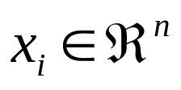
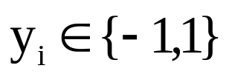
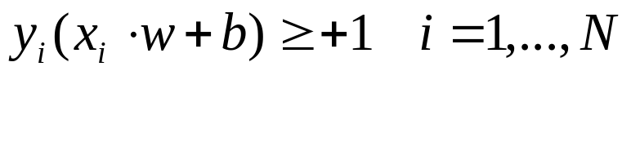
SVM – Cont.
Linear Support Vector Machine
Given a set of points with label
The SVM finds a hyperplane defined by the pair (w,b)
(where w is the normal to the plane and b is the distance from the origin)
s.t.
x – feature vector, b- bias, y- class label, ||w|| - margin

Slide 53
SVM – Cont.
What if the data is not linearly separable?
Project the data to high dimensional space where it is linearly separable and then we can use linear SVM – (Using Kernels)
(0,1)
+
+
-
+
-1
0
+1
-
+
(0,0)
(1,0)

Slide 54
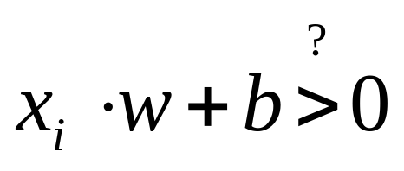
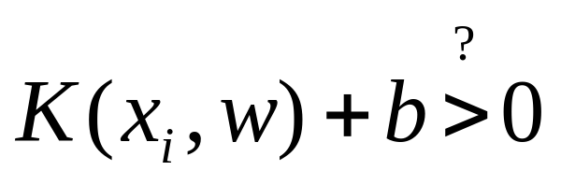
Non-Linear SVM
Classification using SVM (w,b)
In non linear case we can see this as
Kernel – Can be thought of as doing dot product
in some high dimensional space

Slide 55
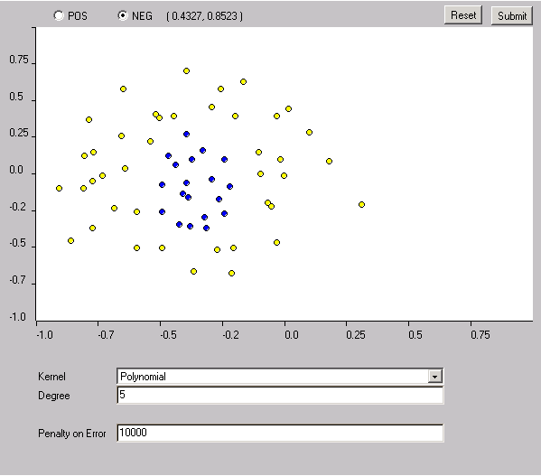
Example of Non-linear SVM

Slide 56
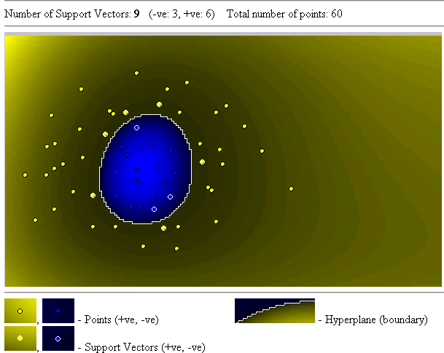
Results

Slide 57
SVM vs. Neural Network
SVM
  Relatively new concept
  Nice Generalization properties
  Hard to learn – learned in batch mode using quadratic programming techniques
  Using kernels can learn very complex functions
Neural Network
  Quiet Old
  Generalizes well but doesn’t have strong mathematical foundation
  Can easily be learned in incremental fashion
  To learn complex functions – use multilayer perceptron (not that trivial)

Slide 58
SVM Related Links
http://svm.dcs.rhbnc.ac.uk/
http://www.kernel-machines.org/
C. J. C. Burges. A Tutorial on Support Vector Machines for Pattern Recognition. Knowledge Discovery and Data Mining, 2(2), 1998.
SVM^{light} – Software (in C) http://ais.gmd.de/~thorsten/svm_light
BOOK: An Introduction to Support Vector Machines
N. Cristianini and J. Shawe-Taylor
Cambridge University Press

Slide 59
Chapter 7. Classification and Prediction
What is classification? What is prediction?
Issues regarding classification and prediction
Classification by decision tree induction
Bayesian Classification
Classification by Neural Networks
Classification by Support Vector Machines (SVM)
Classification based on concepts from association rule mining
Other Classification Methods
Prediction
Classification accuracy
Summary

Slide 60
Association-Based Classification
Several methods for association-based classification
  ARCS: Quantitative association mining and clustering of association rules (Lent et al’97)
    It beats C4.5 in (mainly) scalability and also accuracy
  Associative classification: (Liu et al’98)
    It mines high support and high confidence rules in the form of “cond_set => y”, where y is a class label
  CAEP (Classification by aggregating emerging patterns) (Dong et al’99)
    Emerging patterns (EPs): the itemsets whose support increases significantly from one class to another
    Mine Eps based on minimum support and growth rate

Slide 61
Chapter 7. Classification and Prediction
What is classification? What is prediction?
Issues regarding classification and prediction
Classification by decision tree induction
Bayesian Classification
Classification by Neural Networks
Classification by Support Vector Machines (SVM)
Classification based on concepts from association rule mining
Other Classification Methods
Prediction
Classification accuracy
Summary

Slide 62
Other Classification Methods
k-nearest neighbor classifier
case-based reasoning
Genetic algorithm
Rough set approach
Fuzzy set approaches

Slide 63
Instance-Based Methods
Instance-based learning:
  Store training examples and delay the processing (“lazy evaluation”) until a new instance must be classified
Typical approaches
  k-nearest neighbor approach
    Instances represented as points in a Euclidean space.
  Locally weighted regression
    Constructs local approximation
  Case-based reasoning
    Uses symbolic representations and knowledge-based inference

Slide 64
The k-Nearest Neighbor Algorithm
All instances correspond to points in the n-D space.
The nearest neighbor are defined in terms of Euclidean distance.
The target function could be discrete- or real- valued.
For discrete-valued, the k-NN returns the most common value among the k training examples nearest to xq.
Vonoroi diagram: the decision surface induced by 1-NN for a typical set of training examples.
_
.
_
_
.
+
_
.
+
.
.
_
xq
+
_
.
+

Slide 65
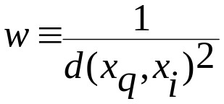
Discussion on the k-NN Algorithm
The k-NN algorithm for continuous-valued target functions
  Calculate the mean values of the k nearest neighbors
Distance-weighted nearest neighbor algorithm
  Weight the contribution of each of the k neighbors according to their distance to the query point x_{q}
    giving greater weight to closer neighbors
  Similarly, for real-valued target functions
Robust to noisy data by averaging k-nearest neighbors
Curse of dimensionality: distance between neighbors could be dominated by irrelevant attributes.
  To overcome it, axes stretch or elimination of the least relevant attributes.

Slide 66
Case-Based Reasoning
Also uses: lazy evaluation + analyze similar instances
Difference: Instances are not “points in a Euclidean space”
Example: Water faucet problem in CADET (Sycara et al’92)
Methodology
  Instances represented by rich symbolic descriptions (e.g., function graphs)
  Multiple retrieved cases may be combined
  Tight coupling between case retrieval, knowledge-based reasoning, and problem solving
Research issues
  Indexing based on syntactic similarity measure, and when failure, backtracking, and adapting to additional cases

Slide 67
Remarks on Lazy vs. Eager Learning
Instance-based learning: lazy evaluation
Decision-tree and Bayesian classification: eager evaluation
Key differences
  Lazy method may consider query instance xq when deciding how to generalize beyond the training data D
  Eager method cannot since they have already chosen global approximation when seeing the query
Efficiency: Lazy - less time training but more time predicting
Accuracy
  Lazy method effectively uses a richer hypothesis space since it uses many local linear functions to form its implicit global approximation to the target function
  Eager: must commit to a single hypothesis that covers the entire instance space

Slide 68
Genetic Algorithms
GA: based on an analogy to biological evolution
Each rule is represented by a string of bits
An initial population is created consisting of randomly generated rules
  e.g., IF A₁ and Not A₂ then C₂ can be encoded as 100
Based on the notion of survival of the fittest, a new population is formed to consists of the fittest rules and their offsprings
The fitness of a rule is represented by its classification accuracy on a set of training examples
Offsprings are generated by crossover and mutation

Slide 69

Rough Set Approach
Rough sets are used to approximately or “roughly” define equivalent classes
A rough set for a given class C is approximated by two sets: a lower approximation (certain to be in C) and an upper approximation (cannot be described as not belonging to C)
Finding the minimal subsets (reducts) of attributes (for feature reduction) is NP-hard but a discernibility matrix is used to reduce the computation intensity

Slide 70

Fuzzy Set Approaches
Fuzzy logic uses truth values between 0.0 and 1.0 to represent the degree of membership (such as using fuzzy membership graph)
Attribute values are converted to fuzzy values
  e.g., income is mapped into the discrete categories {low, medium, high} with fuzzy values calculated
For a given new sample, more than one fuzzy value may apply
Each applicable rule contributes a vote for membership in the categories
Typically, the truth values for each predicted category are summed

Slide 71
Chapter 7. Classification and Prediction
What is classification? What is prediction?
Issues regarding classification and prediction
Classification by decision tree induction
Bayesian Classification
Classification by Neural Networks
Classification by Support Vector Machines (SVM)
Classification based on concepts from association rule mining
Other Classification Methods
Prediction
Classification accuracy
Summary

Slide 72
What Is Prediction?
Prediction is similar to classification
  First, construct a model
  Second, use model to predict unknown value
    Major method for prediction is regression
      Linear and multiple regression
      Non-linear regression
Prediction is different from classification
  Classification refers to predict categorical class label
  Prediction models continuous-valued functions

Slide 73
Predictive Modeling in Databases
Predictive modeling: Predict data values or construct generalized linear models based on the database data.
One can only predict value ranges or category distributions
Method outline:
  Minimal generalization
  Attribute relevance analysis
  Generalized linear model construction
  Prediction
Determine the major factors which influence the prediction
  Data relevance analysis: uncertainty measurement, entropy analysis, expert judgement, etc.
Multi-level prediction: drill-down and roll-up analysis

Slide 74
Regress Analysis and Log-Linear Models in Prediction
Linear regression: Y = α + β X
  Two parameters , α and β specify the line and are to be estimated by using the data at hand.
  using the least squares criterion to the known values of Y1, Y2, …, X1, X2, ….
Multiple regression: Y = b0 + b1 X1 + b2 X2.
  Many nonlinear functions can be transformed into the above.
Log-linear models:
  The multi-way table of joint probabilities is approximated by a product of lower-order tables.
  Probability: p(a, b, c, d) = αab βacχad δbcd

Slide 75

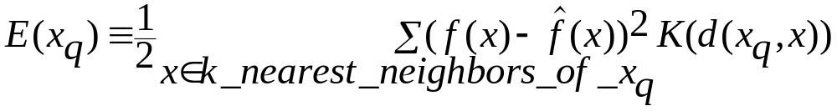
Locally Weighted Regression
Construct an explicit approximation to f over a local region surrounding query instance xq.
Locally weighted linear regression:
  The target function f is approximated near xq using the linear function:
  minimize the squared error: distance-decreasing weight K
  the gradient descent training rule:
In most cases, the target function is approximated by a constant, linear, or quadratic function.

Slide 76
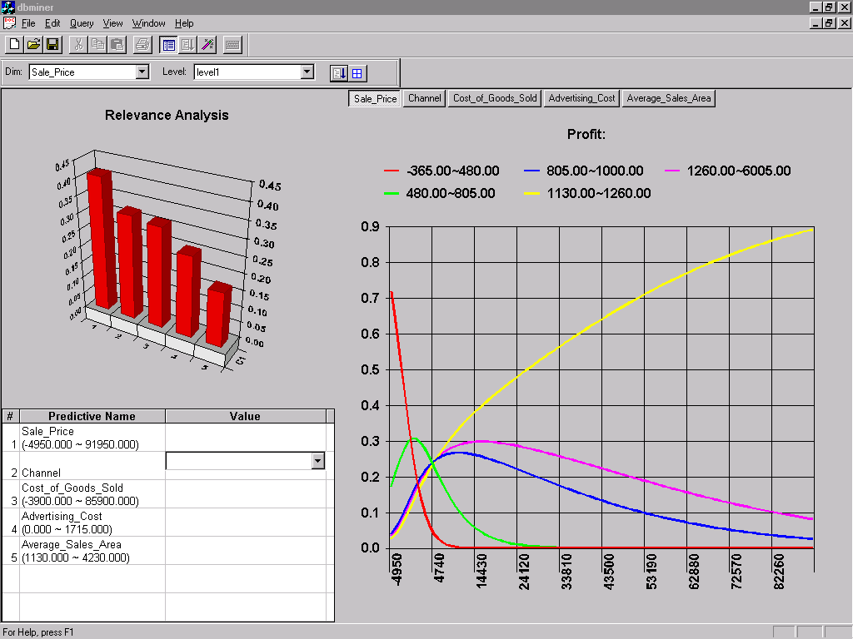
Prediction: Numerical Data

Slide 77
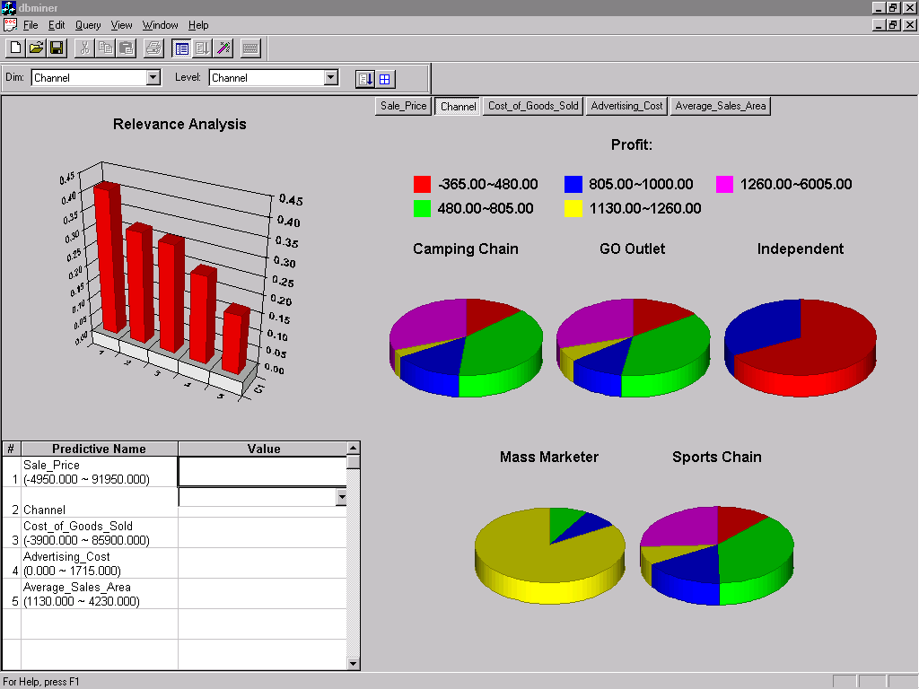
Prediction: Categorical Data

Slide 78
Chapter 7. Classification and Prediction
What is classification? What is prediction?
Issues regarding classification and prediction
Classification by decision tree induction
Bayesian Classification
Classification by Neural Networks
Classification by Support Vector Machines (SVM)
Classification based on concepts from association rule mining
Other Classification Methods
Prediction
Classification accuracy
Summary

Slide 79
Classification Accuracy: Estimating Error Rates
Partition: Training-and-testing
  use two independent data sets, e.g., training set (2/3), test set(1/3)
  used for data set with large number of samples
Cross-validation
  divide the data set into k subsamples
  use k-1 subsamples as training data and one sub-sample as test data—k-fold cross-validation
  for data set with moderate size
Bootstrapping (leave-one-out)
  for small size data

Slide 80
Bagging and Boosting
General idea
Training data
Altered Training data
Altered Training data
……..
Aggregation ….
Classification method (CM)
Classifier C
CM
Classifier C1
CM
Classifier C2
Classifier C*

Slide 81
Bagging
Given a set S of s samples
Generate a bootstrap sample T from S. Cases in S may not appear in T or may appear more than once.
Repeat this sampling procedure, getting a sequence of k independent training sets
A corresponding sequence of classifiers C1,C2,…,Ck is constructed for each of these training sets, by using the same classification algorithm
To classify an unknown sample X,let each classifier predict or vote
The Bagged Classifier C* counts the votes and assigns X to the class with the “most” votes

Slide 82
Boosting Technique — Algorithm
Assign every example an equal weight 1/N
For t = 1, 2, …, T Do
  Obtain a hypothesis (classifier) h^{(t)} under w^{(t)}
  Calculate the error of h(t) and re-weight the examples based on the error . Each classifier is dependent on the previous ones. Samples that are incorrectly predicted are weighted more heavily
  Normalize w^{(t+1)} to sum to 1 (weights assigned to different classifiers sum to 1)
Output a weighted sum of all the hypothesis, with each hypothesis weighted according to its accuracy on the training set

Slide 83
Bagging and Boosting
Experiments with a new boosting algorithm, freund et al (AdaBoost )
Bagging Predictors, Brieman
Boosting Naïve Bayesian Learning on large subset of MEDLINE, W. Wilbur

Slide 84
Chapter 7. Classification and Prediction
What is classification? What is prediction?
Issues regarding classification and prediction
Classification by decision tree induction
Bayesian Classification
Classification by Neural Networks
Classification by Support Vector Machines (SVM)
Classification based on concepts from association rule mining
Other Classification Methods
Prediction
Classification accuracy
Summary

Slide 85
Summary
Classification is an extensively studied problem (mainly in statistics, machine learning & neural networks)
Classification is probably one of the most widely used data mining techniques with a lot of extensions
Scalability is still an important issue for database applications: thus combining classification with database techniques should be a promising topic
Research directions: classification of non-relational data, e.g., text, spatial, multimedia, etc..

Slide 86
References (1)
C. Apte and S. Weiss. Data mining with decision trees and decision rules. Future Generation Computer Systems, 13, 1997.
L. Breiman, J. Friedman, R. Olshen, and C. Stone. Classification and Regression Trees. Wadsworth International Group, 1984.
C. J. C. Burges. A Tutorial on Support Vector Machines for Pattern Recognition. Data Mining and Knowledge Discovery, 2(2): 121-168, 1998.
P. K. Chan and S. J. Stolfo. Learning arbiter and combiner trees from partitioned data for scaling machine learning. In Proc. 1st Int. Conf. Knowledge Discovery and Data Mining (KDD'95), pages 39-44, Montreal, Canada, August 1995.
U. M. Fayyad. Branching on attribute values in decision tree generation. In Proc. 1994 AAAI Conf., pages 601-606, AAAI Press, 1994.
J. Gehrke, R. Ramakrishnan, and V. Ganti. Rainforest: A framework for fast decision tree construction of large datasets. In Proc. 1998 Int. Conf. Very Large Data Bases, pages 416-427, New York, NY, August 1998.
J. Gehrke, V. Gant, R. Ramakrishnan, and W.-Y. Loh, BOAT -- Optimistic Decision Tree Construction . In SIGMOD'99 , Philadelphia, Pennsylvania, 1999

Slide 87
References (2)
M. Kamber, L. Winstone, W. Gong, S. Cheng, and J. Han. Generalization and decision tree induction: Efficient classification in data mining. In Proc. 1997 Int. Workshop Research Issues on Data Engineering (RIDE'97), Birmingham, England, April 1997.
B. Liu, W. Hsu, and Y. Ma. Integrating Classification and Association Rule Mining. Proc. 1998 Int. Conf. Knowledge Discovery and Data Mining (KDD'98) New York, NY, Aug. 1998.
W. Li, J. Han, and J. Pei, CMAR: Accurate and Efficient Classification Based on Multiple Class-Association Rules, , Proc. 2001 Int. Conf. on Data Mining (ICDM'01), San Jose, CA, Nov. 2001.
J. Magidson. The Chaid approach to segmentation modeling: Chi-squared automatic interaction detection. In R. P. Bagozzi, editor, Advanced Methods of Marketing Research, pages 118-159. Blackwell Business, Cambridge Massechusetts, 1994.
M. Mehta, R. Agrawal, and J. Rissanen. SLIQ : A fast scalable classifier for data mining. (EDBT'96), Avignon, France, March 1996.

Slide 88
References (3)
T. M. Mitchell. Machine Learning. McGraw Hill, 1997.
S. K. Murthy, Automatic Construction of Decision Trees from Data: A Multi-Diciplinary Survey, Data Mining and Knowledge Discovery 2(4): 345-389, 1998
J. R. Quinlan. Induction of decision trees. Machine Learning, 1:81-106, 1986.
J. R. Quinlan. Bagging, boosting, and c4.5. In Proc. 13th Natl. Conf. on Artificial Intelligence (AAAI'96), 725-730, Portland, OR, Aug. 1996.
R. Rastogi and K. Shim. Public: A decision tree classifer that integrates building and pruning. In Proc. 1998 Int. Conf. Very Large Data Bases, 404-415, New York, NY, August 1998.
J. Shafer, R. Agrawal, and M. Mehta. SPRINT : A scalable parallel classifier for data mining. In Proc. 1996 Int. Conf. Very Large Data Bases, 544-555, Bombay, India, Sept. 1996.
S. M. Weiss and C. A. Kulikowski. Computer Systems that Learn: Classification and Prediction Methods from Statistics, Neural Nets, Machine Learning, and Expert Systems. Morgan Kaufman, 1991.
S. M. Weiss and N. Indurkhya. Predictive Data Mining. Morgan Kaufmann, 1997.

Slide 89

www.cs.uiuc.edu/~hanj
Thank you !!!

